Slide 1
IBM Cloud Private Overview

Slide 2
Enterprises are rapidly adopting cloud capabilities
Example: Financial services application portfolio
CHALLENGES
Refactoring complex, interconnected applications and data
Maintaining performance and SLA requirements for applications, data and integrations
Multi-provider shared responsibility models for security and compliance
Integration, Data management, service assurance and governance across multiple cloud providers
Rapidly evolving technology choices (IaaS, PaaS, FaaS) and concerns of vendor lock-in
Organizational and cultural changes to adopt DevOps transformations
NOTE: The above is a representative example only
More ready for cloud
May be ready for cloud
Not ready for cloud
What are “best” cloud technology choices and process changes needed ?
What are the options to optimize environments that are not cloud-ready ?
Notes:
An assessment of CBM components and their readiness to move to cloud is based on following assumptions
This assessment is for existing banks where on-premise datacentre, hardware and applications are deployed
Underlying applications are considered for these components
Since this is a running bank, core banking solution and ERP are assumed to be old or not ready for cloud
Some of the components which may have newer systems like CRM, Analytics, Marketing, BPM-based systems are assumed to be ready
Some of the assumptions may slightly vary depending on cloud options (public, private (hosted / managed etc), hybrid)
Some of the components may not have automation currently – in these cases we have assumed that they are more ready with born-on-cloud solutions
For the percentage determination, an approxinmate 35% is assumed from existing applications. Some of the CBM components shown may not have any applications.
The above are based on specific assumptions based on IBM’s experience with banks. This assessment will change from bank to bank based on their applications, application integration data privacy and other factors.

Slide 3
Broadening the adoption of cloud
Preserve, standardize and automate subset of existing applications
Target: 20-30% Full Automation
Modernize and cloud- enable majority of
infrastructure and
applications
Target: 70-80%
Cloud-first approach to new applications and processes
Target: All new applications
Key Challenges:
Cultural transformation is complex and limits the scope & velocity of movement to cloud native development & management
Lack of integrated solutions and tools to build new cloud native applications while integrating & evolving existing applications
Operational challenges in integrating, managing and securing cloud and on-premises applications and data

Slide 4
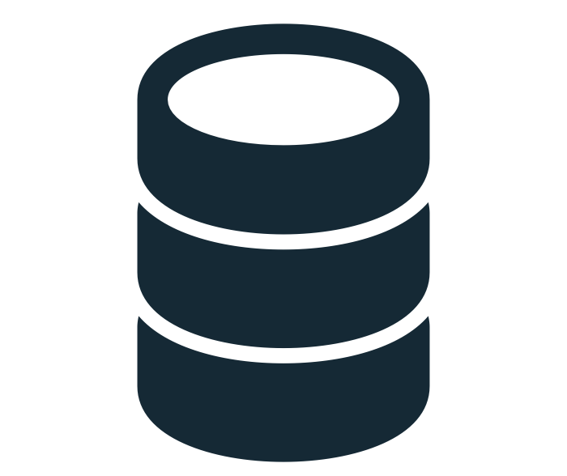

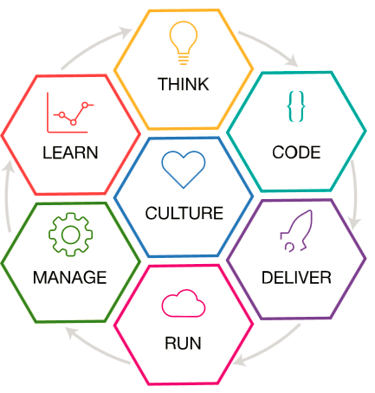
Adoption requires multiple concurrent approaches
Application
Portfolio
Lift-Standardize-Consolidate-Automate-Shift
Evolution to Cloud-based Application
Bare metal, VMs, Containers, Automation - SDDC
Base Virtualization with Standardization & Automation
Customer Information
Contain-Expose-Extend
Cloud native
Loosely-Coupled
12-factor
Horizontal Scaling
Eventually consistent
Microservices
Auto-scaling
DevOps & CI
Self-recovering
API Creation & Management, Connectivity & Integration
Payment Systems
Refactor/Create as Cloud-Native/Microservices
Event-Driven, aPaas, Containers, Microservices
Business Process
Data Classification, Movement & Governance
New Applications
Cognitive Data Classification, High-volume data transfer, Metadata Management
VMs | Containers | aPaaS | iPaaS
Event Driven
On-premises | Off-premises

Slide 5
Key use cases are driving private cloud adoption
Use Case #1
Use Case #2
Use Case #3
Create new cloud-native applications
Modernize and optimize existing applications
Opening up enterprise data centers to work with cloud services
Multi-cloud management and orchestration

Slide 6
Key use cases are driving private cloud adoption
Use Case #1
Use Case #2
Use Case #3
Create new cloud-native applications
Modernize and optimize existing applications
Opening up enterprise data centers to work with cloud services
Multi-cloud management and orchestration

Slide 7
Use case #1: IBM Cloud Private for cloud-native applications
Use case #1: Developers need access to a platform of capabilities to create cloud native applications that meet the security and regulatory requirements of their organization.
IBM’s Capabilities:
IBM Microclimate
APM for microservices
Enterprise grade application development services integrated with the platform runtimes, data and analytics, messaging, DevOps services, and so forth.

Slide 8
Key use cases are driving private cloud adoption
Use Case #1
Use Case #2
Use Case #3
Create new cloud-native applications
Modernize and optimize existing applications
Opening up enterprise data centers to work with cloud services
Multi-cloud management and orchestration

Slide 9



Use case #2: Enterprise applications transformation journey
1
OPTIMIZE
2
MOVE TO CLOUD
3
CONTAINERIZE
4
REFACTOR
Reduce cost and improve performance by selecting the right license and deployment model for existing workloads.
Move workloads to the cloud to benefit from Cloud economics, scale, deployment automation, and improved development agility.
Developers improve agility using containers to continuously deliver, leveraging extreme standardisation and automation.
Refactor applications to cloud native architectures to encompass APIs, micro-services and cognitive capability for innovation and disruption.
Enterprise
application
Enterprise
application
Enterprise
application
Enterprise
application
Enterprise
application
EJB
Servlet
µService
µService
On-Premises
Cloud Affinity
XaaS

Slide 10
Use case #2: IBM Cloud Private to cloud-enable applications
Use case #2: Developers need to cloud enable applications that meet security and regulatory needs. IBM Cloud private provides the platform for rapidly developing and deploying cloud enabled applications, while meeting the security and regulatory needs of the enterprise.
IBM’s capabilities
Transformation Advisor provides guidance on where to run your critical workloads
Next generation versions of industry leading IBM Middleware and Analytics (WAS, MQ, DB2) to speed innovation and gain new insights into data
Vulnerability assessment
Elastic runtimes enable the enterprise to scale up and scale down as needed

Slide 11
Key use cases are driving private cloud adoption
Use Case #1
Use Case #2
Use Case #3
Create new cloud-native applications
Modernize and optimize existing applications
Opening up enterprise data centers to work with cloud services
Multi-cloud management and orchestration

Slide 12
Use case #3: IBM Cloud Private for hybrid cloud applications
Use case #3: Enterprises need to integrate data and application services (from other locations) in their new cloud native and cloud enabled applications which are running in their own data center.
IBM’s capabilities
Kubernetes-based orchestration platform
API Management, Application Integration Suite
Cloud foundry platform for service syndication
Multi-cloud deployments through CAM
APM for Hybrid Workload

Slide 13




Use case #3: New applications need an agile cloud architecture
Front-end
BL-Tier
Back-end
Micro Apps
Enabled Apps
Transactions
Records
Micro Apps
Native Apps
Public
Off-Premise
Processes
Master Data
Hybrid Integration
Transaction Data
Applications
Private
On/Off-Premise
Private
On-Premise
Public
Coding Artifacts
Data Artifacts
Micro Services
Containers
Blueprints
Life Cycle Management
Traditional Apps
Very fast life cycle
Speed of deploy and execution
Scale for the unpredictable
Fast and automate life cycle
Fast repeatable deploys
Elastic behavior
More stable and predictable life cycle
API/WS exposure for up stream levels
Elastic throttling
Notes:
Extending the traditional apps with new born on the cloud applications to have new ways to interact with clients and citizens.
Now we are cloud enabling existing applications to make sure we can deploy faster new add-ons to the existing applications
The Hybrid integration will allow that new born on the cloud apps can consume and provide data to the new cloud enabled applications to enrich the data
Hybrid Integration: Making the right choices for your data and services
fast activation of apps that expose data from traditional back-ends as well as the new
Secure data access through the API management layer
Throttle the activities to prevent overload or to assure golden clients are getting better service
Impact :
faster deployment of the end to end activation of a business application
New automations needed for the cloud enabled
Application deployment and tool chain to expand into all parts of the multi cloud environment

Slide 14


IBM Cloud Private transforms the way IT operations and developers work
Todd
Operations / Admin
Responsible for infrastructure, security, and management of the environment.
Jane
Enterprise Developer
Responsible for modernizing existing applications and creating new Cloud Native Workloads.
IBM Cloud private empowers both developers and administrators to meet business demands:
IT Operations and Administrators can quickly set up a modern, flexible, and compliant private cloud on enterprise infrastructure that enables enterprise developers to innovate; they can also integrate with their existing management tools and processes
Developers can create new cloud-native applications, optimize existing ones, and securely connect their applications with data and services across all clouds

Slide 15
Organizations are focusing on modernization
70% of private cloud adoption is being driven by the need to modernize
Enterprises are modernizing traditional on-prem deployments with a cloud native approach
IBM delivers a framework to accelerate the app modernization journey:
Assess and Plan
Move, Modernize, Deploy
Common Hybrid Cloud Platform
Maintain, Operate, and Support

Slide 16




IBM Cloud Private brings cloud native to the enterprise
Rapid Innovation
Hybrid Integration
Investment Leverage
Management & Compliance
Open Kubernetes-based container platform
Cloud Foundry for app dev and deployment
DevOps toolchain integration
Integration capabilities to unlock and connect
Secure access to public cloud services (AI, Blockchain)
Consistent experience across private/public
Containerized versions of IBM Middleware
Prescriptive guidance to optimize workloads
Work with existing apps, data, skills, infrastructure
Core operational services including logging, monitoring, security
Flexibility to integrate with existing tools and processes

Slide 17

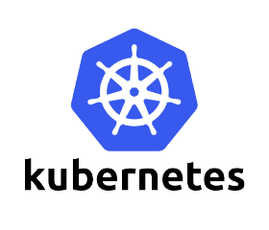
IBM Cloud Private: Next Generation Open Platform
IBM Middleware, Data, Analytics and Developer Services
Core Operational Services
Kubernetes Container Orchestration
Platform
Choose your infrastructure: Power, z, OpenStack, VMWare, Public Cloud
17
Notes:
Talk through the 4 tenets
*****
IBM Cloud Private allows companies to build on existing investments in IT infrastructure, applications and developer skills by taking advantage of new opportunities in the cloud for new and existing workloads.
For example, a Data Scientist in a health care company can access analytics and machine learning services, either via containers in the private cloud or secure connections to public cloud services, to uncover new insights for improving patient care.
A financial services company can modernize 1000’s of applications to increase agility in development and test, and to reduce cost and risk of migration.
To address enterprise use cases, you must deliver enterprise capabilities. IBM Cloud Private does this across the 4 key tenets on which it was built:
Business Innovation – IBM Cloud Private is a complete platform for enterprise developers to quickly create and deliver cloud-native applications to the market
Kubernetes-based container platform
Cloud Foundry for prescribed application development and deployment
Integrated DevOps toolchain
Integration – IBM Cloud Private has capabilities that enable you to open your data center to other clouds to integrate capabilities and services with the applications you are developing:
Full catalog of enterprise-grade integration services
API consistency with public clouds
Investment Protection – For years you’ve invested in middleware and infrastructure across your enterprise; IBM Cloud Private helps you utlize those investments in new and innovative ways:
Prescriptive guidance through a new solution called the Transformation Advisor, which scans your applications and advises on which workloads are good candidates to modernize with IBM Cloud Private
Container-based versions of IBM Middleware and Analytics (WAS, MQ, DB2)
The flexibility to run on your existing infrastructure
Management and Compliance
IBM Cloud Private includes a catalog of core operational services to help you manage your environment, including monitoring, log management, and security
In addition to those capabilities provided, IBM Cloud Private provides the flexibility to easily integrate with your existing tools and processes, aligning with your organizations IT standards

Slide 18
Enterprise Content Catalog
Toolchain & Runtimes
IBM Microclimate
IBM WebSphere Liberty
Open Liberty ^{(open source)}
IBM SDK for Node.js
Swift runtime ^{(open source)}
Messaging
IBM MQ Advanced for Developers
IBM MQ Advanced
Rabbit MQ ^{(open source)}
Integration
IBM Integration Bus for Developers
IBM Integration Bus
IBM DataPower Gateway for Developers
IBM DataPower Gateway Virtual Edition
Data Services
IBM Db2 Dev-C
IBM Data Server Manager (for Db2 Dev-C)
IBM Db2 Direct Advanced Edition / AESE with Data Server Manager
IBM Db2 Warehouse Dev-C
IBM Db2 Warehouse Enterprise
IBM Cloudant Developer Edition
MongoDB ^{(open source)}
PostreSQL ^{(open source)}
MariaDB ^{(open source)}
Galera for MariaDB ^{(open source)}
App Modernization Tooling
IBM Transformation Advisor
Multi-cloud Management
IBM Cloud Automation Manager
Data Science and Business Analytics
IBM Data Science Experience Developer Edition
IBM Data Science Experience Local
Data Governance and Integration
IBM InfoSphere Information Server for Evaluation
Mobile
IBM Mobile Foundation
Network Analysis Tooling
Skydive ^{(open source)}
HPC / HPDA
IBM Spectrum LSF Community Edition
IBM Spectrum Symphony Community Ed.
+
18
18

Slide 19
IBM Cloud Private Editions
Community Edition
Cloud Native
Enterprise
Community
Platform
Kubernetes (+ Helm)
Core services
Content catalog
Platform
Kubernetes (+ Helm)
Core services
Content catalog (Containers)
Platform
Kubernetes (+Helm)
Core services
Content catalog (Containers)
Cloud Foundry (Optional)
Cloud Foundry (Optional)
Freely Available in Docker Hub
IBM Enterprise Software
Microservice Builder
WebSphere Liberty
IBM SDK for node.js
Cloud Automation Manager
IBM Enterprise Software
Cloud Native Edition, plus:
WAS ND
MQ Advanced
API Connect Professional
19
19

Slide 20

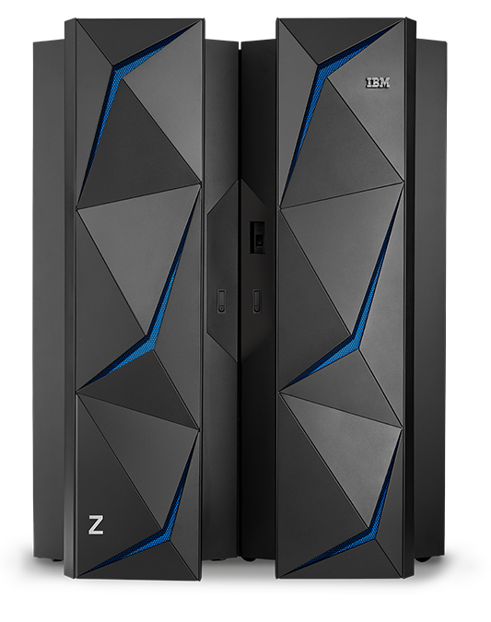

IBM Cloud Private in a heterogeneous environment
Inside your Secured Firewall
IBM Cloud Private (ICP) is an untethered Platform as a Service that combines the speed, agility and flexibility of the public cloud, with the security and performance guarantees of an on-premises cloud.
ICP provides a core platform runtime based on Kubernetes and common services like logging, metering, auditing, user access control etc. along with a rich catalog of IBM and open-source products.
ICP master on Intel or Power
Secured Connection
Security
service
service
service
service
service
ICP
ICP
ICP
ICP
ICP
Linux
Linux
Linux
Linux
z/VM
KVM
PowerVM
VMWare ESXi
Public Cloud
CPs/mem/IO/hipersockets
Power
(On-prem)
Intel
(On-prem)
Linux on Z / LinuxONE

